Slide 1

Hybrid Powered Industrial Data Center
A Machine learning analysis

Slide 2
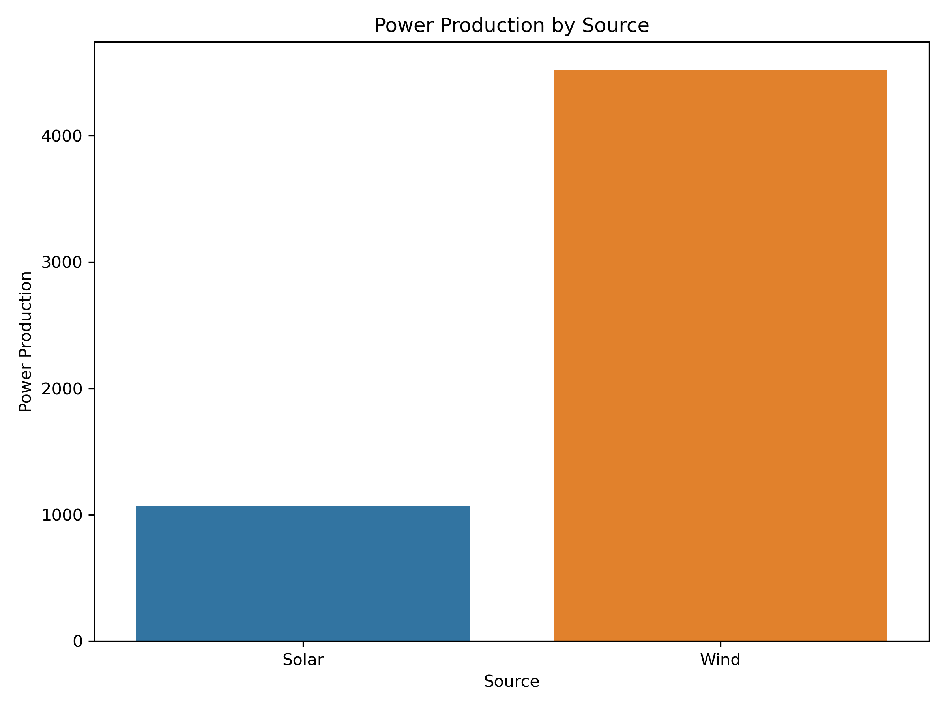
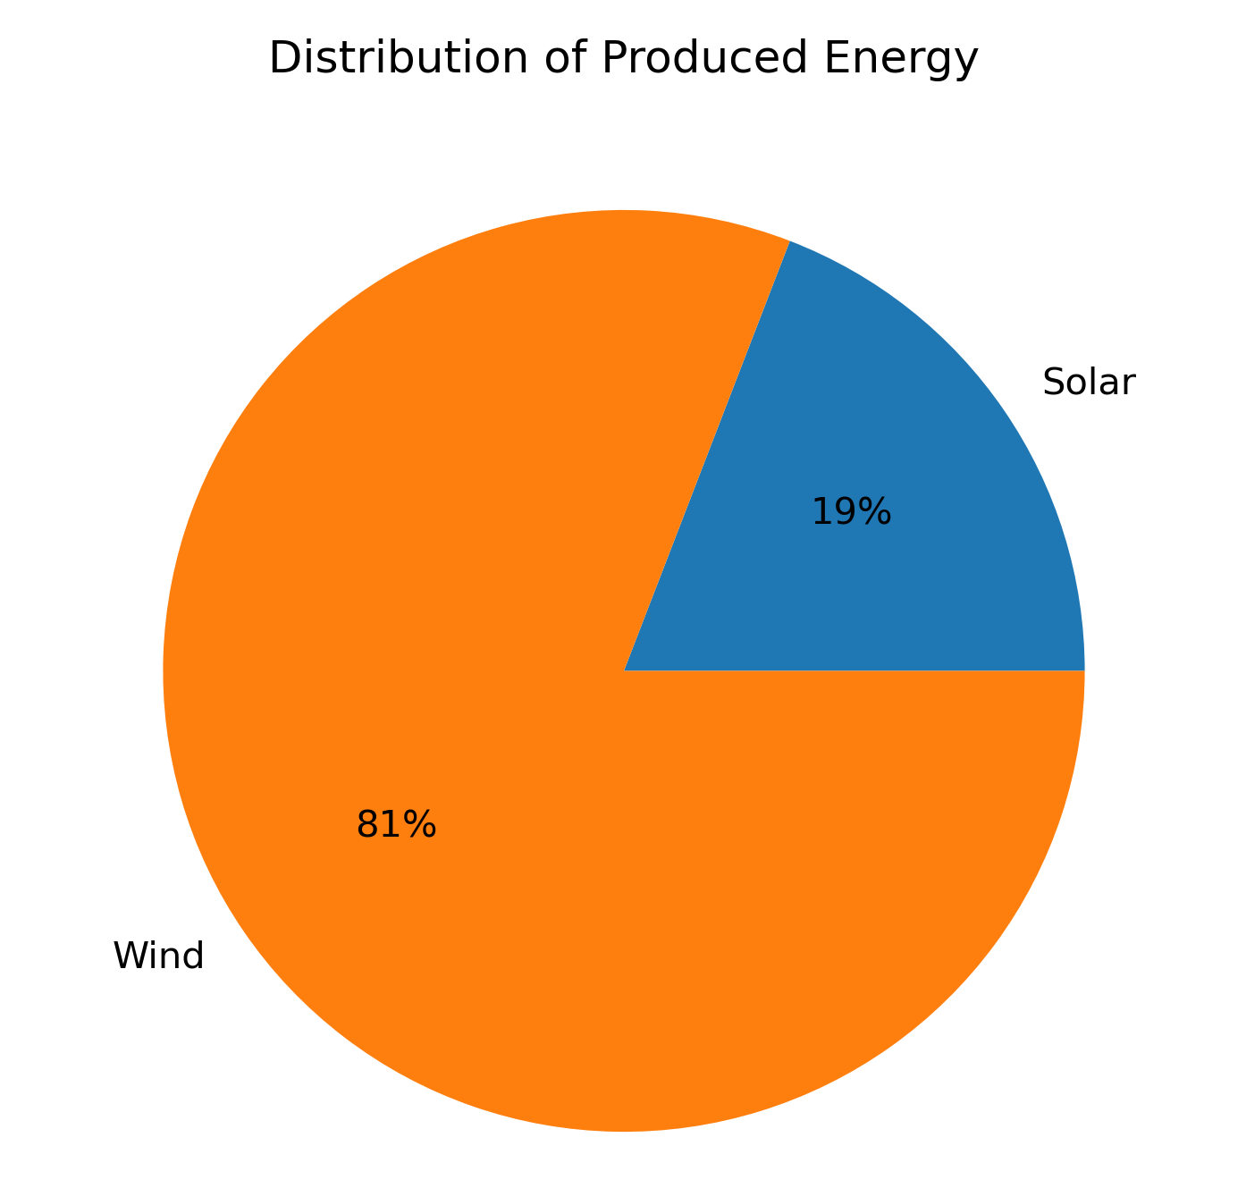
Introduction
Renewable energy sources:
Solar
Wind
Wind produces more energy.
Hybrid system consisting both wind and solar power generators.
Hybrid system is most efficient.

Slide 3
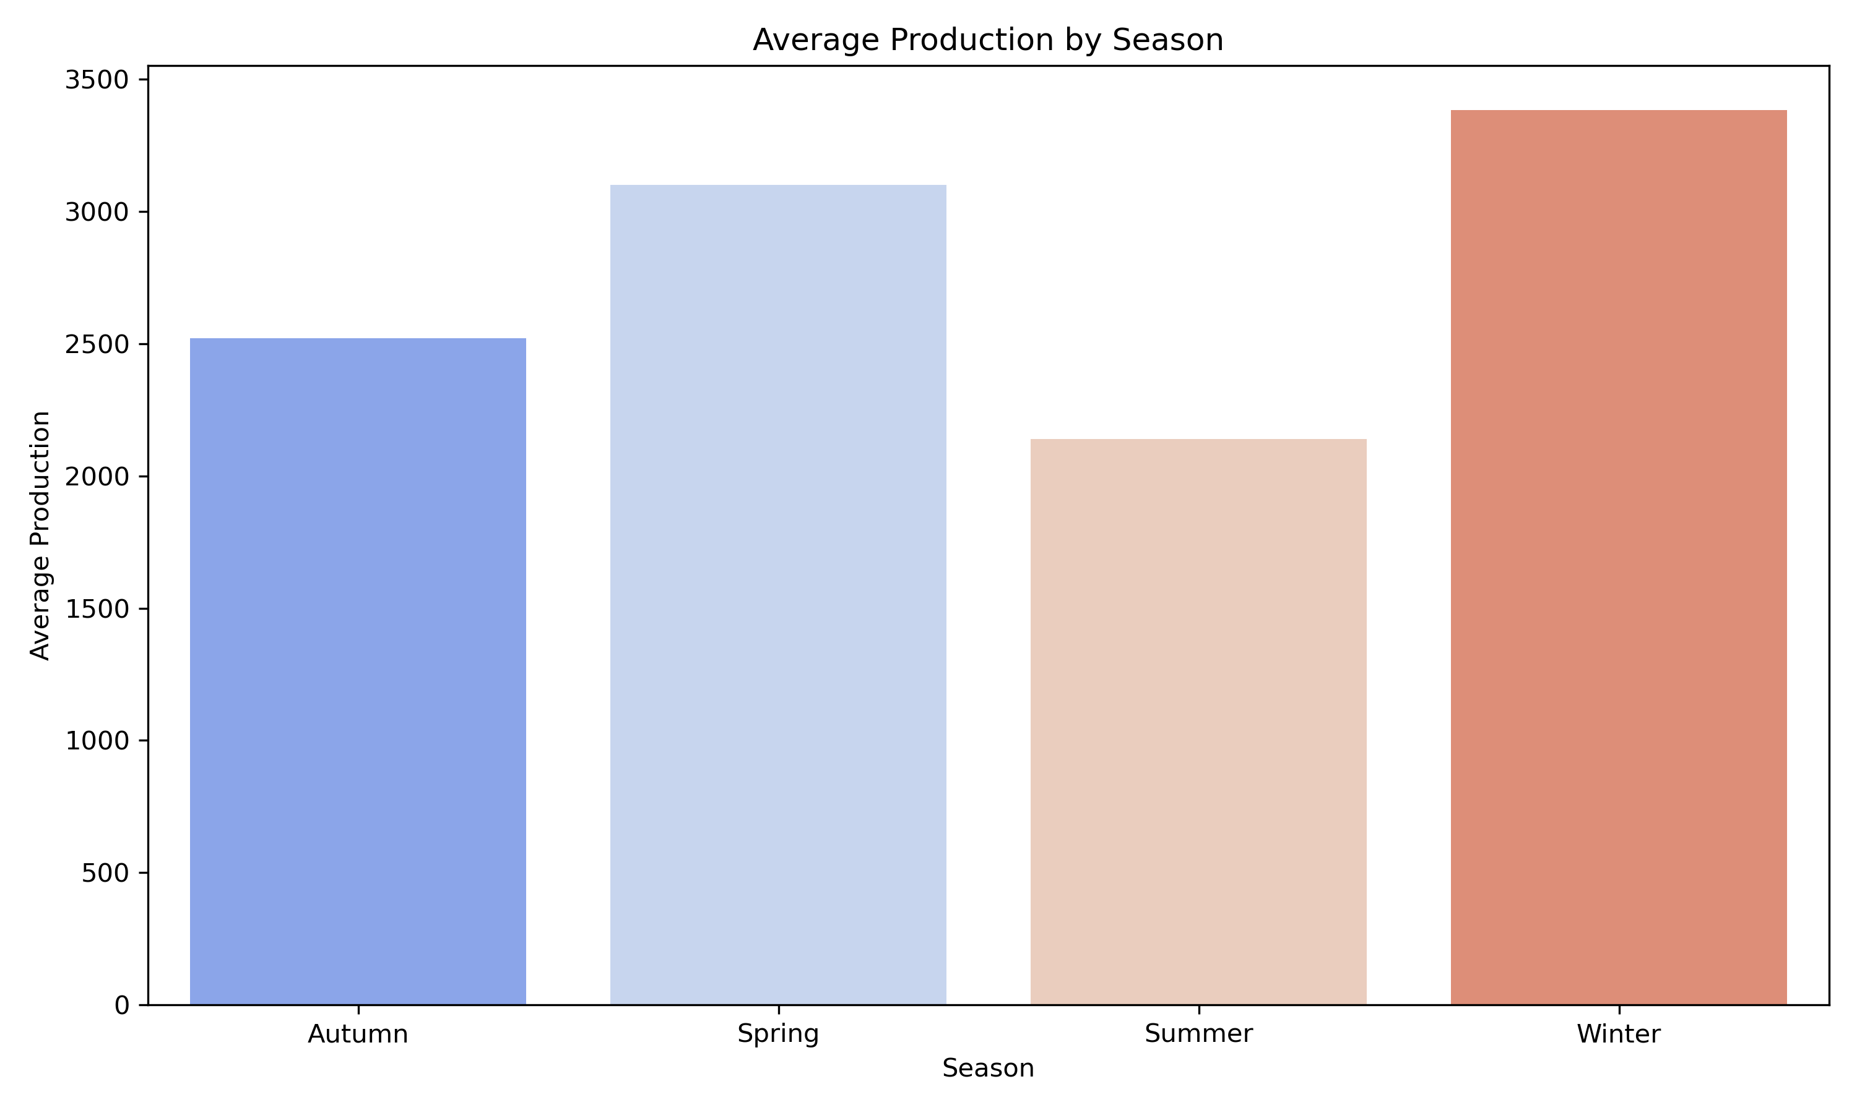
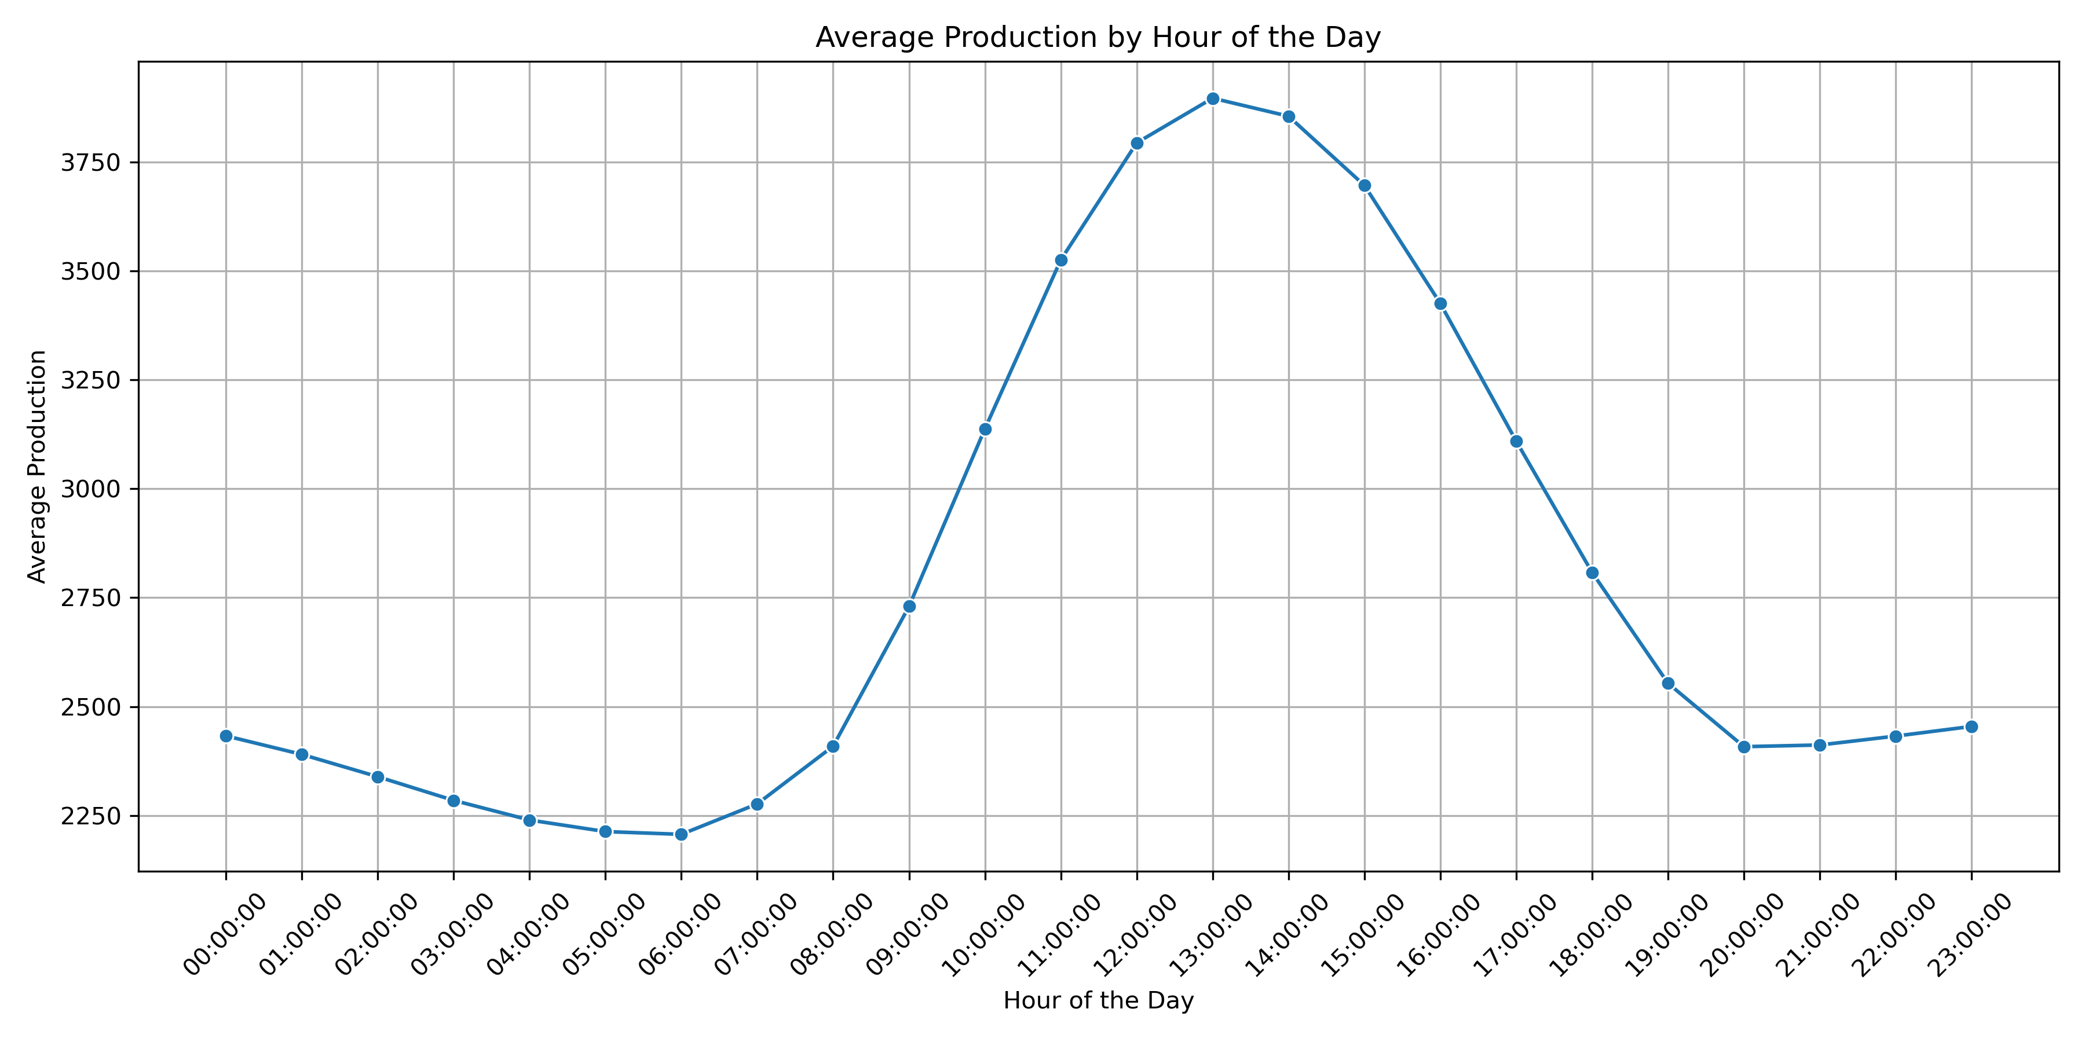
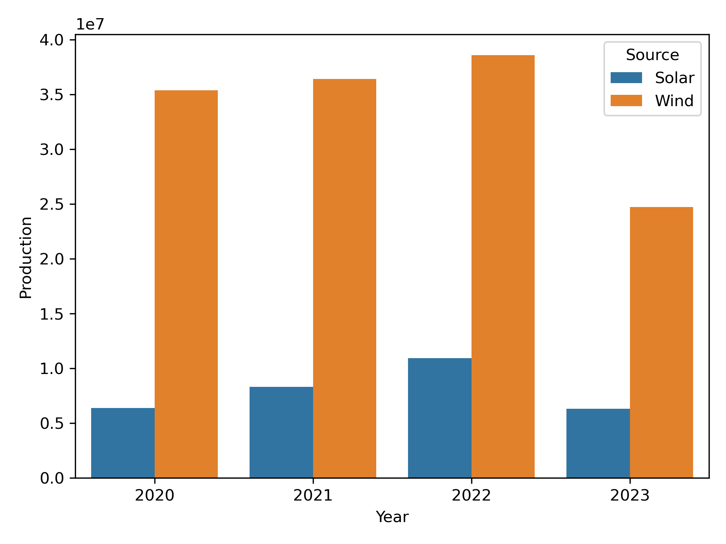
Both sources of energy alternatively run in hybrid station.
Power more generated on winter.
Power more produced at night.
Over time production improved.

Slide 4
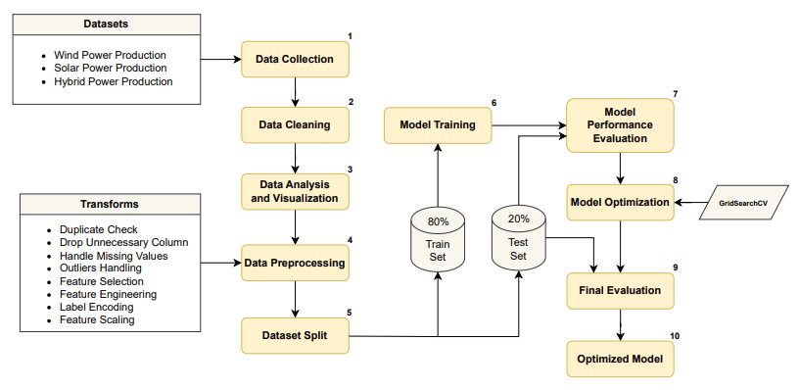
System Infrastructure

Slide 5
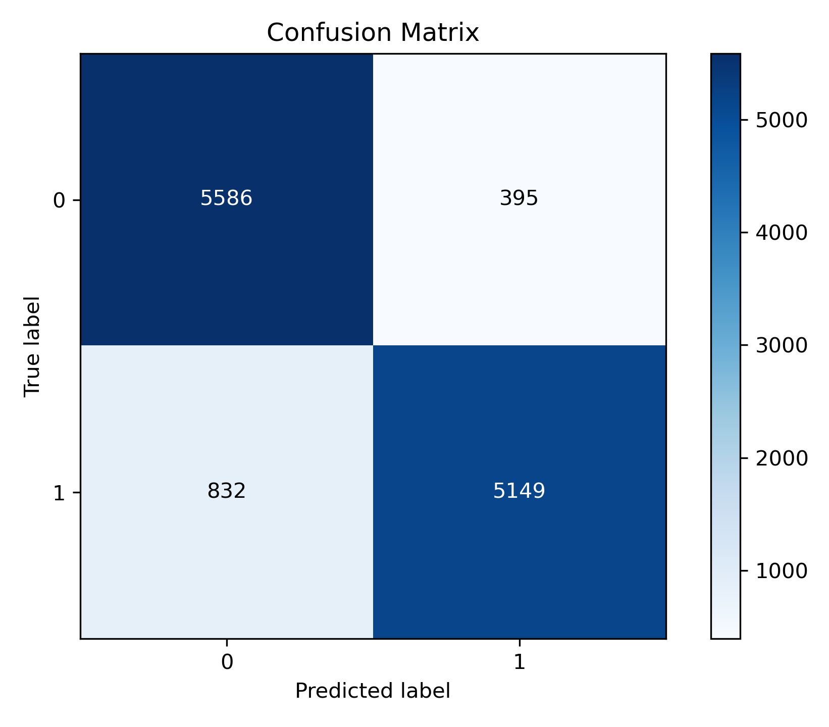
Machine Learning Analysis
Model | Accuracy
Decision Tree | 89%
Random Forest | 90%
Linear Regression | 90%
Gradient Boosting | 88%
K-Nearest Neighbors | 88%
AdaBoost | 82%
Random Forest CM
Linear Regression CM
Model Performance Table

